Slide 1
20260125 F24I38 step.7 TEMP.5 abort issue

Slide 2
Discipline 1. 選定團隊 Form the Team
團隊負責人Team Leader/Dept.: 蔡孟哲/S220
成員Team Member/Dept.:
Name | Department | Position
S210 PE | S210 | 擴散製程課
S220 EQ | S220 | 擴散設備課

Slide 3
Discipline 2.描述問題及現況掌握Describe the Problem
(WHO detected the problem? WHAT is wrong? State the problem in terms of object and defect. WHERE the problem was first detected, describe location of the detection, lot #, WHEN and HOW it was detected)
What | Route : L0547I/L041SI/C050VI / C050VI Qty: 150 pcs
Where | F24
When | 2026.1.25
Extent | Run F24I38 step7 TEMP.5 abort (Drive in time 9:00:00,剩餘1:12:42) 量測 MW THK:601.66/607.69/614.12/597.05/615.26 AVERAGE:607 Å
上貨時間 | 機台 | 程式 | LOC | Lot | Product | Route | Oper | Qty
2026/1/25 00:48 | F24 | F24I38 | 1 | 26040320 | Y5V30Y A | V0417U | 1802 | 25
2026/1/25 00:48 | F24 | F24I38 | 2 | 26040310 | Y5V30Y A | V0417U | 1802 | 25
2026/1/25 00:48 | F24 | F24I38 | 3 | 25523040 | YBF05T G | T0517I | 1802 | 25
2026/1/25 00:48 | F24 | F24I38 | 4 | 25524090 | Y8C01T I | O0562I | 1802 | 25
2026/1/25 00:48 | F24 | F24I38 | 5 | 25524100 | Y8C01T I | O0562I | 1802 | 25
2026/1/25 00:48 | F24 | F24I38 | 6 | 25531980 | Y7S05W C | T046UI | 1802 | 25

Slide 4
Discipline 2.描述問題及現況掌握Describe the Problem
lot History - 調查過程簡述 (Investigation):
設定值
實際值
SampleTime | GC | Tube | Standby Factor | Alarm | Recipe | Recipe Name | Recipe Remaining | Step | Step Remaining | Set_BTM_1 | Set_BTM_2 | Set_CTR_1 | Set_CTR_2 | Set_TOP | Outer_BTM_1 | Outer_BTM_2 | Outer_CTR_1 | Outer_CTR_2 | Outer_TOP
2026/1/25 10:22 | Win310 | F24 |  |  | F24I38 | COPY F11I38 | 0004:11:30 | 7 | 02:02:20 | 1183.5 | 1183.5 | 1187.5 | 1185 | 1185 | 1183.5 | 1183.5 | 1187.5 | 1184.9 | 1185.1
2026/1/25 10:24 | Win310 | F24 |  |  | F24I38 | COPY F11I38 | 0004:09:14 | 7 | 02:00:04 | 1183.5 | 1183.5 | 1187.5 | 1185 | 1185 | 1183.3 | 1183.5 | 1187.5 | 1184.9 | 1185
2026/1/25 10:30 | Win310 | F24 |  |  | F24I38 | COPY F11I38 | 0004:03:38 | 7 | 01:54:28 | 1183.5 | 1183.5 | 1187.5 | 1185 | 1185 | 1183.5 | 1183.5 | 1187.5 | 1184.9 | 1184.9
2026/1/25 10:32 | Win310 | F24 |  |  | F24I38 | COPY F11I38 | 0004:01:15 | 7 | 01:52:05 | 1183.5 | 1183.5 | 1187.5 | 1185 | 1185 | 1183.4 | 1183.6 | 1187.5 | 1185 | 1185
2026/1/25 10:38 | Win310 | F24 |  |  | F24I38 | COPY F11I38 | 0003:55:44 | 7 | 01:46:34 | 1183.5 | 1183.5 | 1187.5 | 1185 | 1185 | 1183.4 | 1183.5 | 1187.5 | 1185 | 1184.9
2026/1/25 10:40 | Win310 | F24 |  |  | F24I38 | COPY F11I38 | 0003:53:23 | 7 | 01:44:13 | 1183.5 | 1183.5 | 1187.5 | 1185 | 1185 | 1183.6 | 1183.5 | 1187.6 | 1184.9 | 1185
2026/1/25 10:46 | Win310 | F24 |  |  | F24I38 | COPY F11I38 | 0003:47:50 | 7 | 01:38:40 | 1183.5 | 1183.5 | 1187.5 | 1185 | 1185 | 1183.4 | 1183.5 | 1187.5 | 1185.1 | 1185
2026/1/25 10:48 | Win310 | F24 |  |  | F24I38 | COPY F11I38 | 0003:45:29 | 7 | 01:36:19 | 1183.5 | 1183.5 | 1187.5 | 1185 | 1185 | 1183.5 | 1183.5 | 1187.5 | 1184.9 | 1184.6
2026/1/25 10:53 | Win310 | F24 |  |  | F24I38 | COPY F11I38 | 0003:40:00 | 7 | 01:30:50 | 1183.5 | 1183.5 | 1187.5 | 1185 | 1185 | 1183.5 | 1183.5 | 1187.5 | 1184.9 | 1185
2026/1/25 10:56 | Win310 | F24 |  |  | F24I38 | COPY F11I38 | 0003:37:35 | 7 | 01:28:25 | 1183.5 | 1183.5 | 1187.5 | 1185 | 1185 | 1183.6 | 1183.6 | 1187.5 | 1185.1 | 1185
2026/1/25 11:01 | Win310 | F24 |  |  | F24I38 | COPY F11I38 | 0003:32:04 | 7 | 01:22:54 | 1183.5 | 1183.5 | 1187.5 | 1185 | 1185 | 1183.6 | 1183.4 | 1187.4 | 1182.4 | 1176.3
2026/1/25 11:04 | Win310 | F24 |  |  | F24I38 | COPY F11I38 | 0003:29:45 | 7 | 01:20:35 | 1183.5 | 1183.5 | 1187.5 | 1185 | 1185 | 1183.5 | 1183.5 | 1187.5 | 1182.4 | 1170
2026/1/25 11:11 | Win310 | F24 |  |  | F24I38 | COPY F11I38 | 0003:21:56 | 7 | 01:12:46 | 1183.5 | 1183.5 | 1187.5 | 1185 | 1185 | 1183.5 | 1183.5 | 1187.5 | 1183.6 | 1166.1
2026/1/25 11:12 | Win310 | F24 |  |  | F24I38 | COPY F11I38 | 0003:21:52 | 7 | 01:12:42 | 1183.5 | 1183.5 | 1187.5 | 1185 | 1185 | 1183.5 | 1183.5 | 1187.5 | 1183.6 | 1166.1
2026/1/25 11:19 | Win310 | F24 | RAMP-EXE |  | F24AB1 | COPY F11I38 | 0002:12:16 | 1 | 02:12:16 | 780 | 780 | 780 | 780 | 780 | 1172.9 | 1175.2 | 1178.2 | 1179.8 | 1161.1
Run F24I38 step7 TEMP.5 abort (Drive in time 9:00:00,剩餘1:12:42)
確認最高溫為1185℃。

Slide 5
Discipline 2.描述問題及現況掌握Describe the Problem
Is/Is Not Analysis table (釐清問題):
 |  | Is | Is Not | Difference/Conclusion
What | object | Temperature | Gas | Temperature-related issue
 | Defect | Temperature abnormal | Temperature normal | Insufficient heating
Where | Location | TOP | BTM-1/BTM-2/CTR-1/CTR-2 | Furnace heater zone
 | Machine | F24 | Other drive in | F24
When | First time | 2026.1.25 | before 2026.1.25 | Specific date started (2026/1/25)
 | Reoccurred | NA | NA | NA
How | Many | 6lots | Other batches | Only this batch
 | Trend | C1 temp cannot reach target casing step.7 abort | Temperature is normal | Temperature cannot reach target

Slide 6
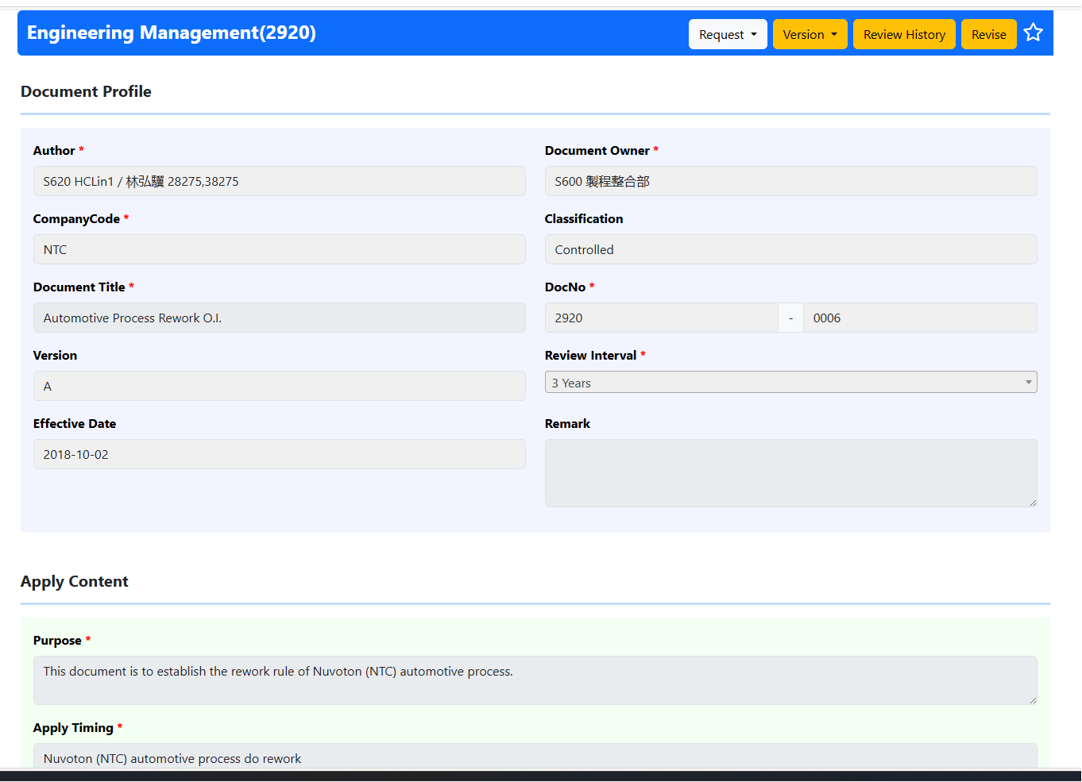
Discipline 3.執行及驗證暫時防堵對策 Contain the Problem
(Define and implement containment actions to isolate the effect of problem from any internal/external customer until corrective action is implemented)
This case 2 lots of V0417U follow O.I 2920-0006 Automotive Process Rework O.I.
Rework rule:
Type E: Continuous process
In the equipment M/D, the wafer is removed equipment and continue to finish the process
Type E rework flow is not allowed for automotive process

Slide 7
Discipline 3.執行及驗證暫時防堵對策 Contain the Problem
(Define and implement containment actions to isolate the effect of problem from any internal/external customer until corrective action is implemented)
3.1 異常產品 (Defect Lots)
項目 Item | 處理方式 Action | 負責人員 Resp | 預定完成日 Due | 實際完成日 Imp. | 處理結果 Verification
26040320 26040310 | WIP REWORK | 李治中 | 2026/1/26 | 2026/1/26 | Do WIP REWORK
3.2 波及產品 (Impact Lots)
項目 Item | 處理方式 Action | 負責人員 Resp | 預定完成日 Due | 實際完成日 Imp. | 處理結果 Verification
共 6 批 150片產品 thermal 不足 | 新建 RKW 程式將 thermal 補足 | 賴瑞澤 | 2026/01/25 | 2026/1/26 | Do RWK recipe ok FH.9950 WAT check

Slide 8
Discipline 3.執行及驗證暫時防堵對策 Contain the Problem
(Define and implement containment actions to isolate the effect of problem from any internal/external customer until corrective action is implemented)
3.3 波及設備 (Impact Machine)
項目 Item | 處理方式 Action | 負責人員 Resp | 預定完成日 Due | 實際完成日 Imp. | 處理結果 Verification
F24 | 將 heater TOP cable 端子重新壓接重鎖 | S220 EQ | 2026/01/25 | 2026/01/25 | 1.鉤表勾 TOP SCR current 正常顯示。 2.Test run check BTM-1~TOP TEMP. stable。
3.4 波及製程 (Impact Route) : 否(No)
項目 Item | 處理方式 Action | 負責人員 Resp | 預定完成日 Due | 實際完成日 Imp. | 處理結果 Verification
NA | NA | NA | NA | NA | NA
3.5 產品召回選項，是否需進行客戶端波及產品的召回? 否(No)
Customer | Product No. | Lot number / Wafer number | Approx. Quantity
NA | NA | NA | NA

Slide 9
Discipline 3.執行及驗證暫時防堵對策 Contain the Problem
(Define and implement containment actions to isolate the effect of problem from any internal/external customer until corrective action is implemented)
F24I38 程式PROFILE
RWK 程式PROFILE
STEP NO. | 1 | 2 | 3 | 4 | 5 | 6
DESCRIPTION | BOAT IN | RAMP UP | RAMP UP | DRIVE-IN | RAMP DOWN | BOAT OUT
TIME | 10' | 10' | 60' | 00:48:18 | 133'20" | -
TEMPERATURE
PROFILE
1200 ℃
900 ℃
800 ℃
Temperature null |  |  |  | T
N2 | 10L | 10L | 10L | 10L | 10L | 10L
O2
H2
T-LC
sO2 | 0.3L | 0.3L
Action :
量測MW 厚度601.66/607.69/614.12/597.05/615.26 AVERAGE:607 Å
F24I38 Step 7 共 9小時,STEP.7 剩01:12:42扣除重複升降溫 thermal , RWK 程式共補 Drive in 00:48:18 .
產品預計安拍於 F42 機台進行 RWK，建立F42RWK
F42RWK:
刪除Step.3~5 oxidation 步驟。
Drive in步驟改為0:48:18。
先補MW 確認程式正常執行，待日班安排產品補RUN，補RUN後FH. 9950 oper. 確認 WAT data .

Slide 10
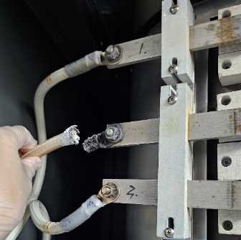
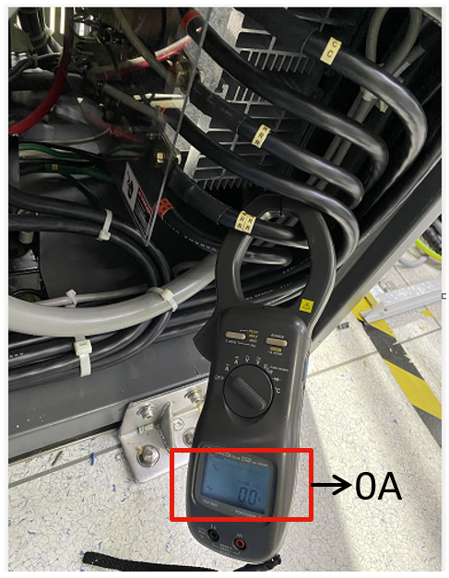
Discipline 4.定義及驗證真因 (Identify the Root Cause)
(Identify all potential causes which could explain why the problem occurred)
4.1 Non-conformance root cause (defect nature / technical root cause):
a) Failure mechanism:
F24 run I38 step.07 TEMP.5 abort → Check TOP TEMP. 實際值低於設定值 20°C 且持續 60sec。
Turun off 208V，Check heater TOP cable burnout，使 SCR 無輸出，則 TOP 無法升溫。
Burnout，使 TOP SCR current=0A

Slide 11
Discipline 4.定義及驗證真因 (Identify the Root Cause)
(Identify all potential causes which could explain why the problem occurred)
4.1 Non-conformance root cause (defect nature / technical root cause):
b) 列出所有可能的原因 (Probable Causes/Factors): Non-conformance
工具 (Tools): 故障樹分析 (Fault Tree Analysis)、魚骨圖 (Fishbone)
TEMP.
Spike thermocouple
SCR control PCB
http://home.rapidbbs.cn/?fromuid=22138
TEMP.5 abort 原因
線圈阻抗
Cable
端子阻抗
Heater

Slide 12
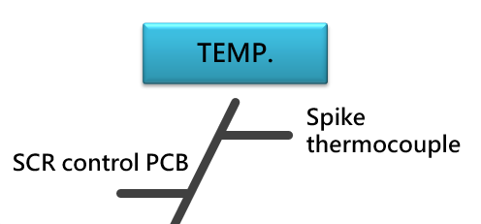
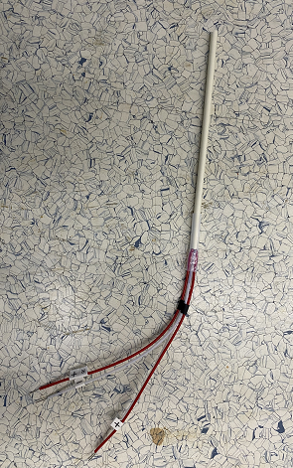
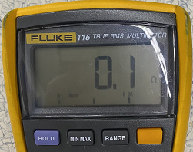
Discipline 4.定義及驗證真因 (Identify the Root Cause)
(Identify all potential causes which could explain why the problem occurred)
4.1 Non-conformance root cause (defect nature / technical root cause):
c) 真因驗證 (Root Cause Verification)
Spike thermocouple： 分析：Measure BTM-1~TOP 5個 zone spike thermocouple 阻抗約為1歐姆：非真因。
spike
thermocouple
+
-

Slide 13
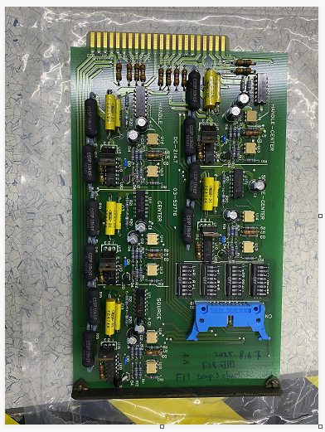
Discipline 4.定義及驗證真因 (Identify the Root Cause)
(Identify all potential causes which could explain why the problem occurred)
4.1 Non-conformance root cause (defect nature / technical root cause):
c) 真因驗證 (Root Cause Verification)
SCR control PCB： 分析：Replace spare SCR control PCB 之後, 鉤表勾 TOP SCR current still 0A：非真因。
SCR control PCB

Slide 14
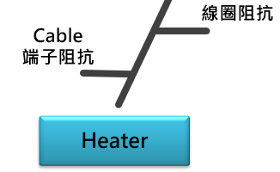
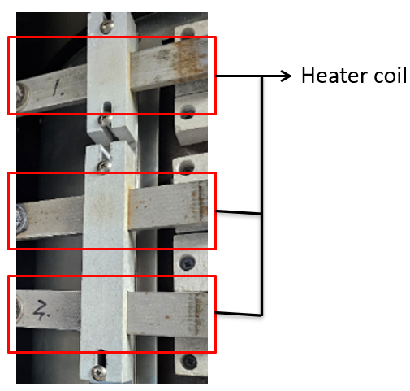
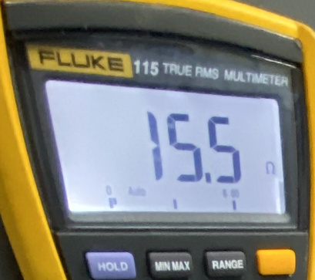
Discipline 4.定義及驗證真因 (Identify the Root Cause)
(Identify all potential causes which could explain why the problem occurred)
4.1 Non-conformance root cause (defect nature / technical root cause):
c) 真因驗證 (Root Cause Verification)
Heater： 1. 線圈阻抗：
分析： Measure heater 線圈阻抗約為1~100歐姆：非真因。
+
-

Slide 15

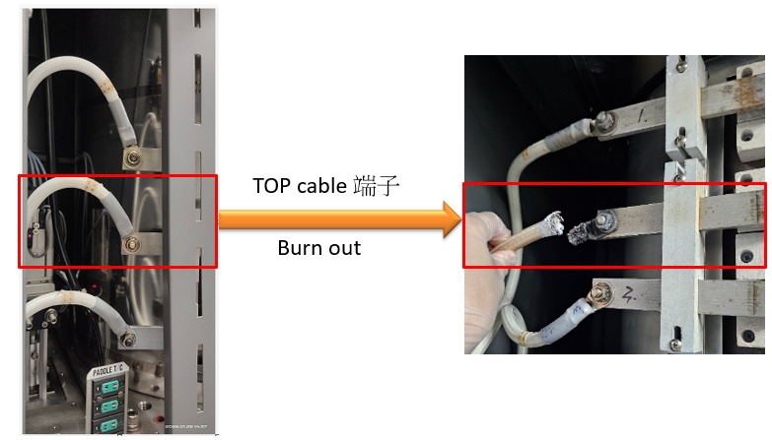
Discipline 4.定義及驗證真因 (Identify the Root Cause)
(Identify all potential causes which could explain why the problem occurred)
4.1 Non-conformance root cause (defect nature / technical root cause):
c) 真因驗證 (Root Cause Verification)
Heater： 2. Cable 端子阻抗。
分析：
a. Heater cable 端子 burnout，使阻抗 show O.L.：真因
補充：因 cable 端子未鎖緊，則實際導電面積所小，使熱過度集中於某處，則金屬端子過熱 burnout。

Slide 16
Discipline 4.定義及驗證真因 (Identify the Root Cause)
(Identify all potential causes which could explain why the problem occurred)
4.1 Non-conformance root cause (defect nature / technical root cause):
b) 列出所有可能的原因 (Probable Causes/Factors): Non-conformance
工具 (Tools): 故障樹分析 (Fault Tree Analysis)、魚骨圖 (Fishbone)
TEMP.
Spike thermocouple
SCR control PCB
http://home.rapidbbs.cn/?fromuid=22138
TEMP.5 abort 原因
線圈阻抗
Cable
端子阻抗
Heater
Conclusion：
Heater cable 端子 burnout，則阻抗 show O.L.，為真因。

Slide 17
Discipline 4.定義及驗證真因 (Identify the Root Cause)
(Identify all potential causes which could explain why the problem occurred)
4.1 Non-conformance root cause (defect nature / technical root cause):
a) 5-Why analysis
Why machine execute TEMP.5 abort？
因為 TEMP.5 實際值低於設定值 20°C 且持續 60sec，則 TEMP.5 abort。
Why TEMP.5 會低於設定值？
因為 TEMP.5 的 SCR 電流為 0A 無輸出，造成 TOP 無法升溫。
Why TEMP.5 的 SCR 電流為 0A？
因為 Heater TEMP.5 cable 端子 burnout。
Why heater TEMP.5 cable 端子會 burnout？
因為 heater TEMP.5 cable 端子過熱。
Why heater TEMP.5 cable 端子會過熱？
因為 TEMP.5 cable 端子無確實被壓緊鎖緊。
b) Conclusion :
因 TEMP.5 cable 端子無確實被壓緊鎖緊，使端子 burnout。

Slide 18
Discipline 4.定義及驗證真因 (Identify the Root Cause)
(Identify all potential causes which could explain why the problem occurred)
4.2 Non-detection / escape root cause (Provide reason to why the current system failed to detect)
a) 5-why:
為何鎖 heater cable 時，無明確規範?
因為鎖 heater cable 未明確指定需使用扭力板手鎖其端子。
b) Conclusion
於 PM table 中新增，使用 28Nm 扭力板手檢查 heater cable 端子鬆緊狀態。

Slide 19
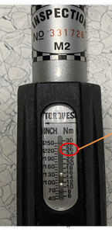
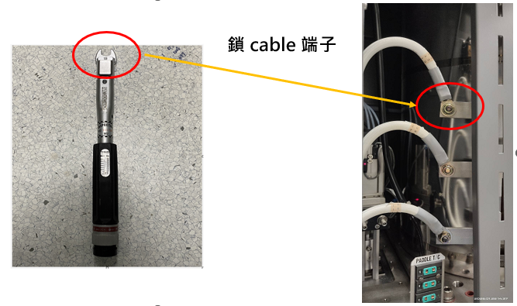
Discipline 5.擬定及驗證永久改善對策Choose and verify permanent corrective action (列出各項執行之對策並檢核其對策有效性)
5.1 What was the chosen corrective action to correct the root cause? (Add photo or diagram where applicable.)
指定鎖 heater cable 端子時，使用 28Nm 扭力板手。
28Nm

Slide 20
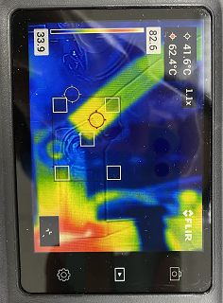
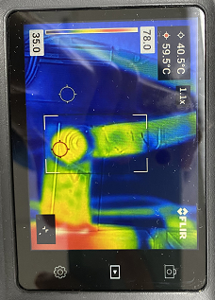
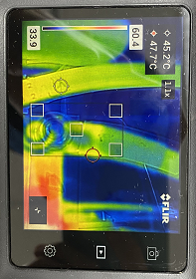
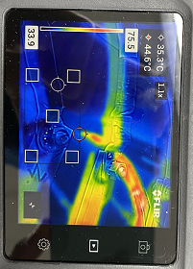
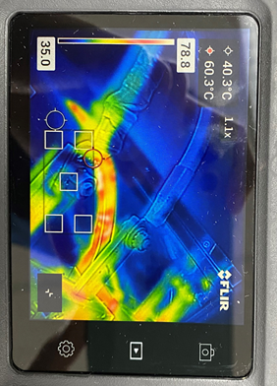
Discipline 5.擬定及驗證永久改善對策Choose and verify permanent corrective action (列出各項執行之對策並檢核其對策有效性)
5.2 Verification of actions effectiveness
使用 28Nm 扭力板手，可將 heater cable 端子確實鎖緊。
使用熱影像檢測 heater cable 接點溫度，均無出現溫度>90°C， 證實 28Nm 是合理的，
如下圖，為 TEMP.1~TEMP.5 熱影像
TEMP.1
TEMP.2
TEMP.3
TEMP.4
TEMP.5

Slide 21
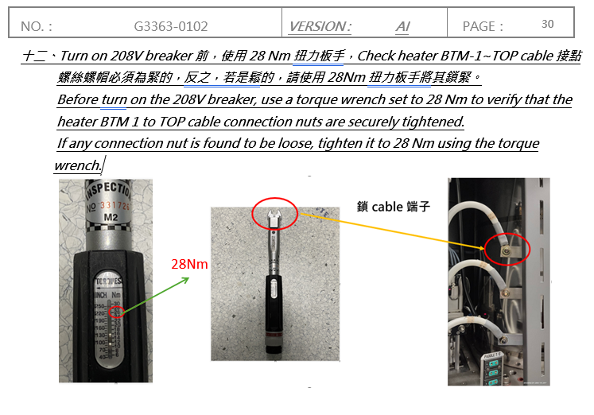
Discipline 5.擬定及驗證永久改善對策Choose and verify permanent corrective action (列出各項執行之對策並檢核其對策有效性)
5.2 Verification of actions effectiveness
修改 TEL OXIDE 爐管降溫 PM O.I. 程序 & PM table 保養紀錄表，新增需要檢查 Heater cable 端子鬆緊狀態，如下圖(放 OI )：

Slide 22
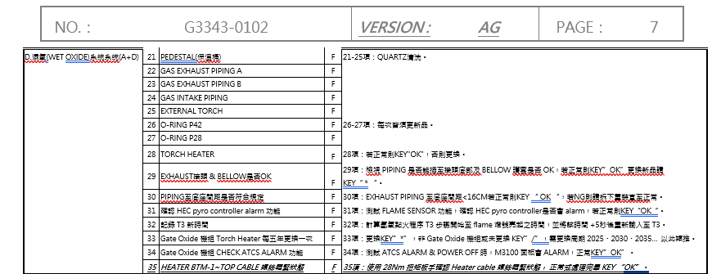
Discipline 5.擬定及驗證永久改善對策Choose and verify permanent corrective action (列出各項執行之對策並檢核其對策有效性)
5.2 Verification of actions effectiveness
修改 TEL OXIDE 爐管降溫 PM O.I. 程序 & PM table 保養紀錄表，新增需要檢查 Heater cable 端子鬆緊狀態，如下圖(放 OI )：

Slide 23
Discipline 6.實施認永久改善對策Corrective Actions Implementation
6.1 For non-conformance root cause (defect nature / technical root cause):
Nbr. | Actions | Who | When | Remarks / Evidence (Document/Spec/Chart #)
1 | 使用 28Nm 扭力板手重鎖接點 | S220 | 2026/01/25 | Test run check 5 zone TEMP. stable & Test run data in SPEC.
6.2 For non-detection / escape root cause
Nbr. | Actions | Who | When | Remarks / Evidence (Document/Spec/Chart #)
1 | 平行展開 Drive in 機組， 用 28Nm 扭力板手檢查 heater cable 鬆緊程度 | S220 | 2026/03/04
2 | 使用 28Nm 扭力板手鎖 heater cable 端子 | S220 | 2026/04/21 | 使用 28Nm 扭力板手後，搭配熱影像檢測接點溫度均無>90°C，證實可將 heater cable 端子確實鎖緊。

Slide 24
Discipline 6.實施認永久改善對策Corrective Actions Implementation
平行展開
用 28Nm 扭力板手，check Drive in 機組 heater cable 端子鬆緊程度。
使用熱影像檢測 Drive in 機組 heater cable 接點溫度。
2026/03/04 Drive in 機組均完成檢查作業。
機台(Drive in) | 完成日期
F02 | 2026/03/04
F04 | 2026/02/04
F05 | 2026/03/04
F08 | 2026/03/04
F09 | 2026/02/02
F10 | 2026/03/04
F11 | 2026/02/02
F15 | 2026/03/04
F24 | 2026/02/05
F33 | 2026/03/04
F42 | 2026/03/04

Slide 25
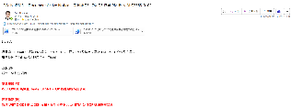
Discipline 7.避免再發Prevent Recurrence (Modify System / Document)
7.1 Systemic Actions:
Factor | Actions | Who | When | Remarks / Evidence (Document/Spec/Chart #)
Practices/ Training | Updated O.I. 與 PM TABLE 上線通知 | S220 | 2026/02/05
Work Instruction | 使用 28Nm 扭力板手鎖 heater cable 端子。 | S220 | 2026/04/21 | 證實可將 heater cable 端子鎖緊，防止再次 burnout。
Specification | 1.Updated G3343-0102 TEL OXIDE 爐管保養紀錄表 2. Updated G3336-0102 TEL OXIDE 爐管 PM Procedure | S220 | 2026/04/21 | 1.修改 G3343-0102 TEL OXIDE 爐管保養紀錄表(AG版)。 2.修改 G3363-0102 TEL OXIDE 爐管降溫 PM 程序(AI版)。
Control Plan | 於 PM table 中新增，需使用 28Nm 扭力板手檢查 heater cable 端子鬆緊狀態。 | S220 | 2026/04/21 | 藉由 PM 時，檢查 heater cable 端子鬆緊狀態，避免再次發生 burnout。
* FMEA (must) | N/A | N/A | N/A | N/A
Error Proofing | 於 PM table 中新增 YPM 時，需用 28Nm 扭力板手 check heater cable 接點鬆緊狀態 | S220 | 2026/04/21 | 1.修改 G3343-0102 TEL OXIDE 爐管保養紀錄表(AG版)。 2.修改 G3363-0102 TEL OXIDE 爐管降溫 PM 程序(AI版)。

Slide 26
Discipline 7.避免再發Prevent Recurrence (Modify System / Document)
7.2 Corrective Actions Fan-out: (水平展開):
Machine/ Process/ Product | Actions | Responsible | Due date
Drive in | 於 PM table 中新增 YPM 時，需使用 28Nm 扭力板手 check heater cable 接點鬆緊狀態 | S220 | 2026/04/21

Slide 27
Discipline 8. Congratulate the Team
Thanks for every member helped in this case.
Reviewed and Approved by:
Name | 2. Position | 3. Date
S220 邱尊護 | SECTION MANAGER | 2026/04/21
S200 李明驥 | DEPARTMENT MANAGER | 2026/04/21

